Slide 1


Disseminating CONUS National Water Model Simulation Data at Watershed Scales to Engage a Broad Community of Water Scientists
Anthony M. Castronova¹, Danielle Tijerina¹, Aubrey L Dugger²,Arezoo Rafieeinasab², Joe Mills², David Gochis²
¹Consortium of Universities for the Advancement of Hydrologic Science ²National Center for Atmospheric Research

Slide 2
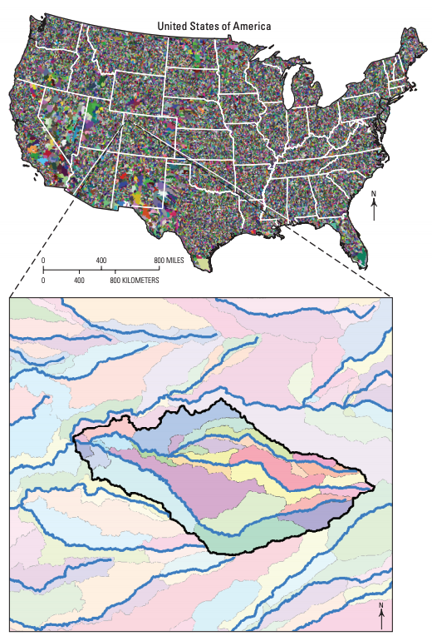
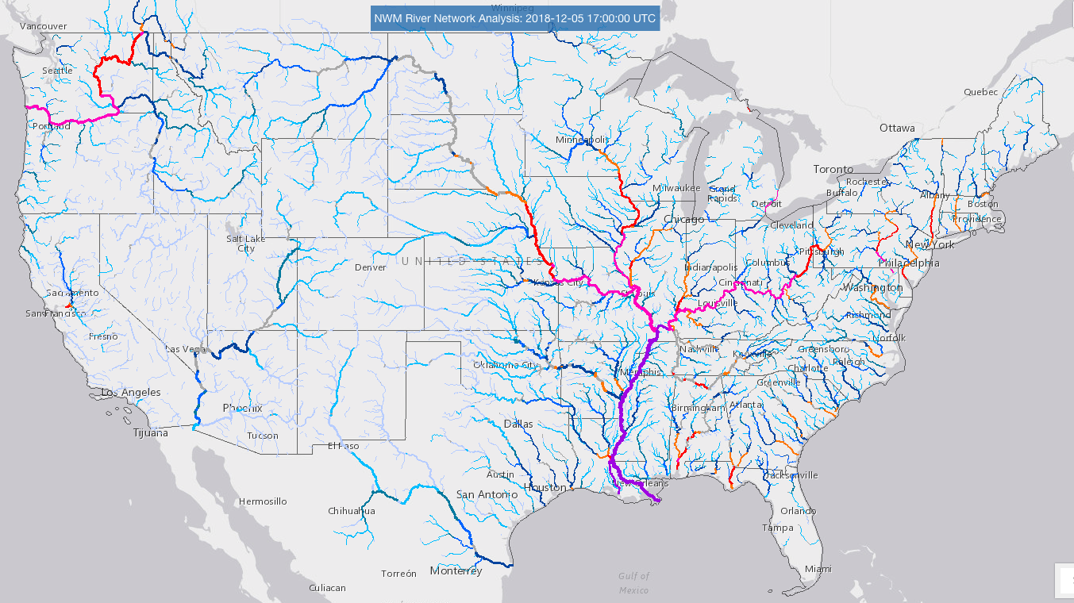
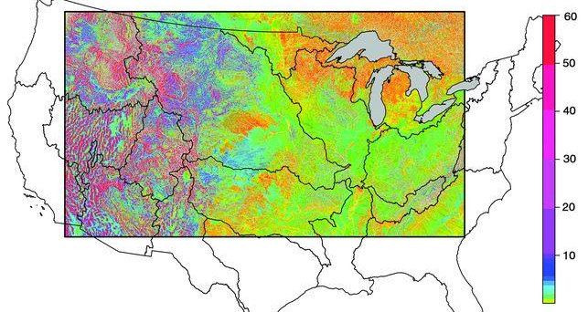
CONUS Models
USGS National Hydrologic Model
OWP/NOAA National Water Model
ParFlow-CONUS
water.noaa.gov
Maxwell & Condon, 2016
Regan et al., 2018

Slide 3
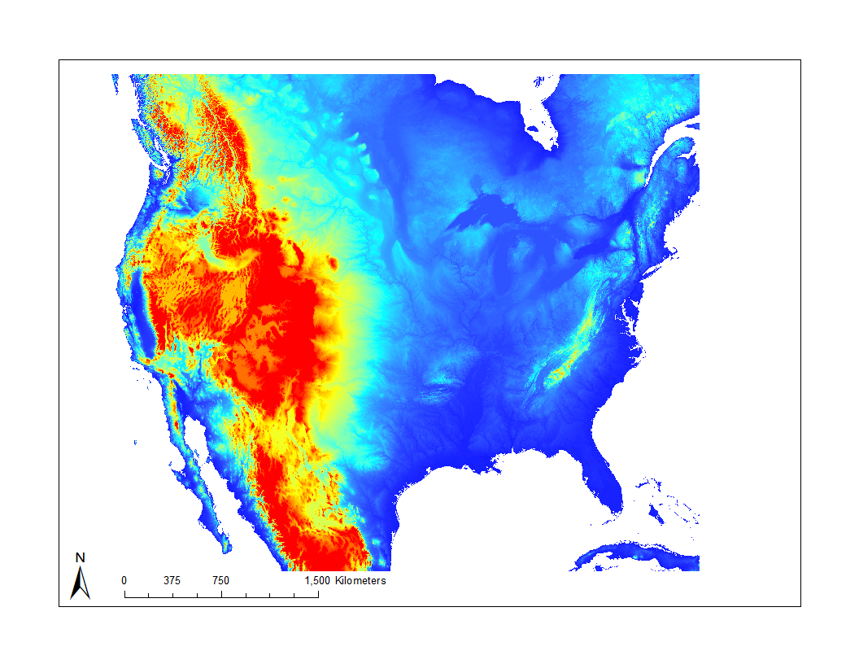
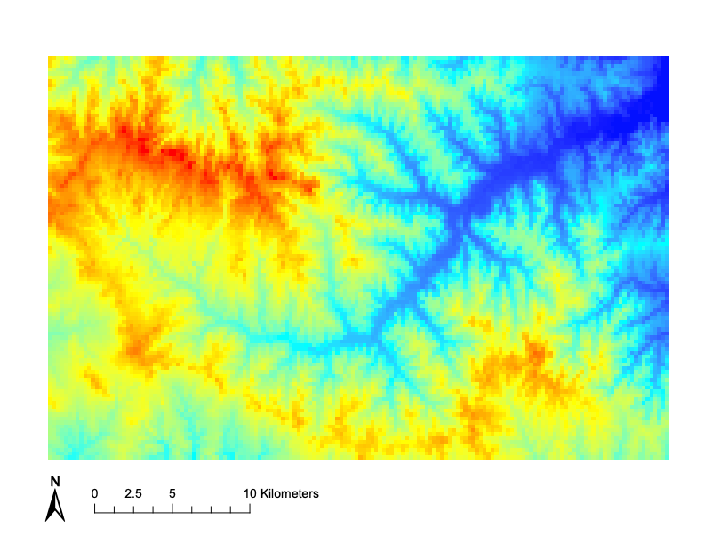
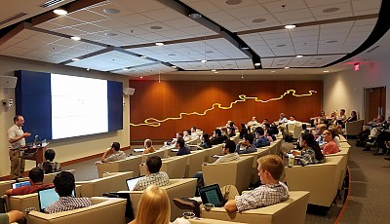
Project Goal
Improve community access to CONUS-scale model domains
Subset at watershed scales
Supporting multiple models
Community contribution
AGU 2018
www.cuahsi.org
3

Slide 4
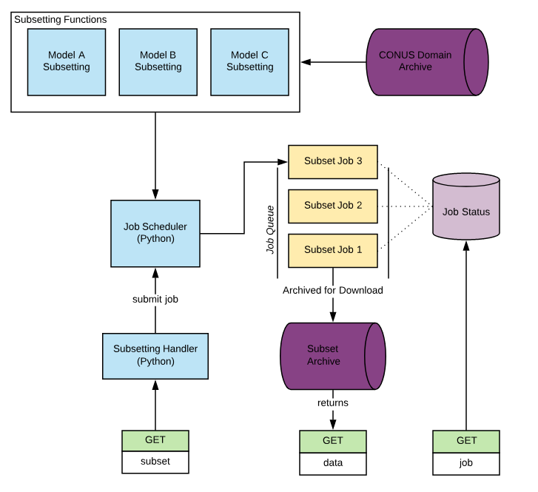
Software Architecture
NCEP DOMAIN Data
Web Service Methods
Domain Subset
Version
Model Name
Bounding Box
Job Status
Job ID
Data Download
Job ID
NCAR Subsetting
R Code
1
3
2

Slide 5
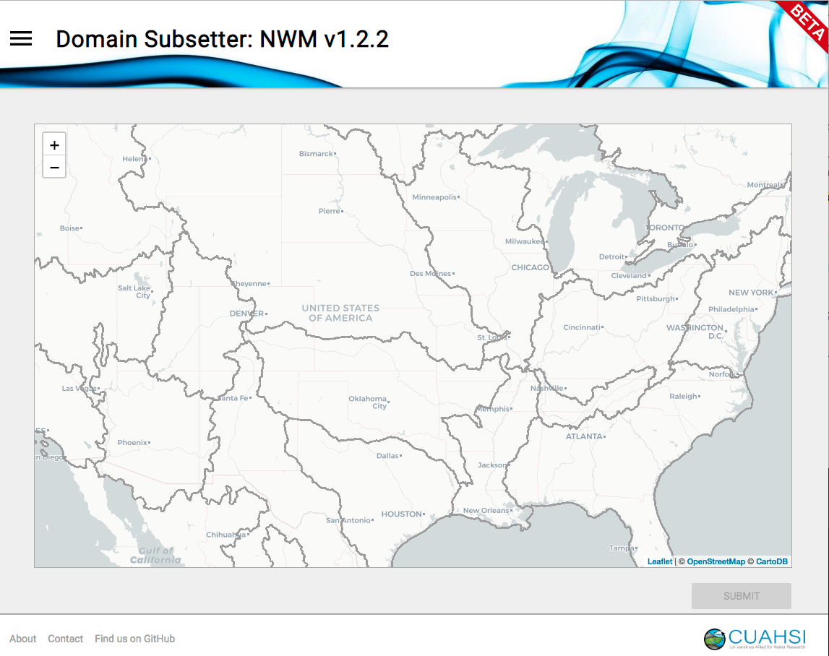
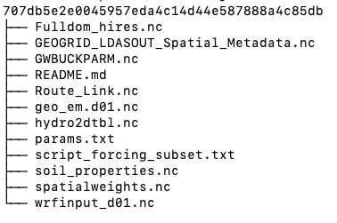
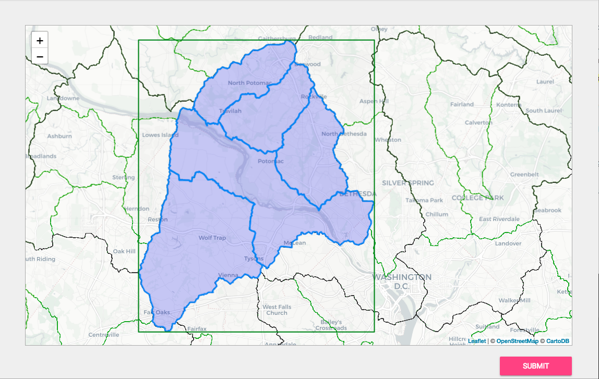
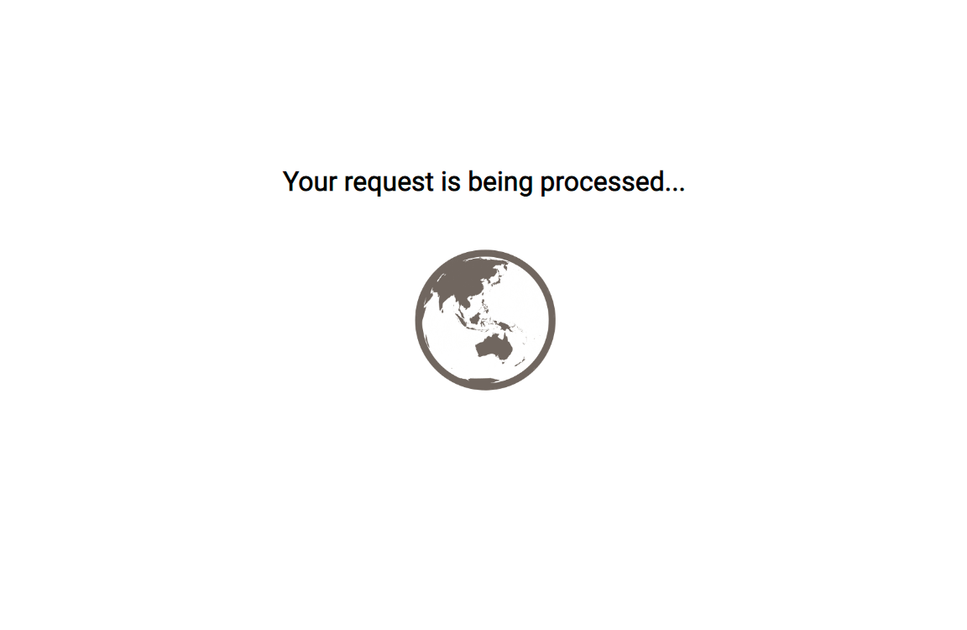
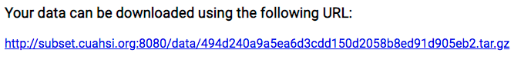
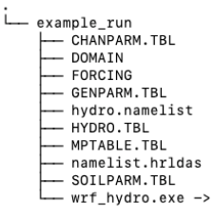
Software Implementation
DOMAIN files we provide
Notes:
No lakes and reservoirs
No nudging
No Restart

Slide 6
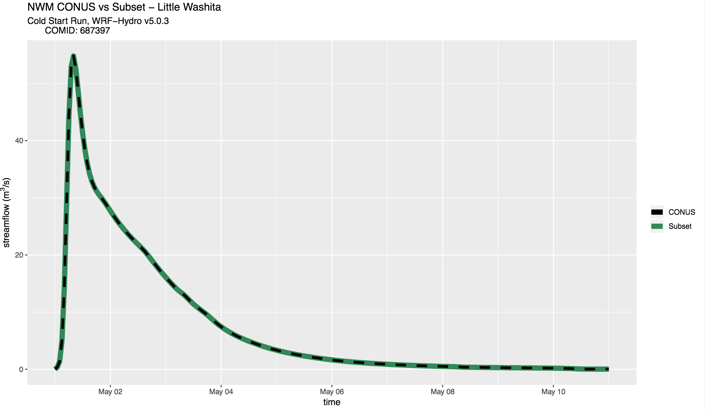
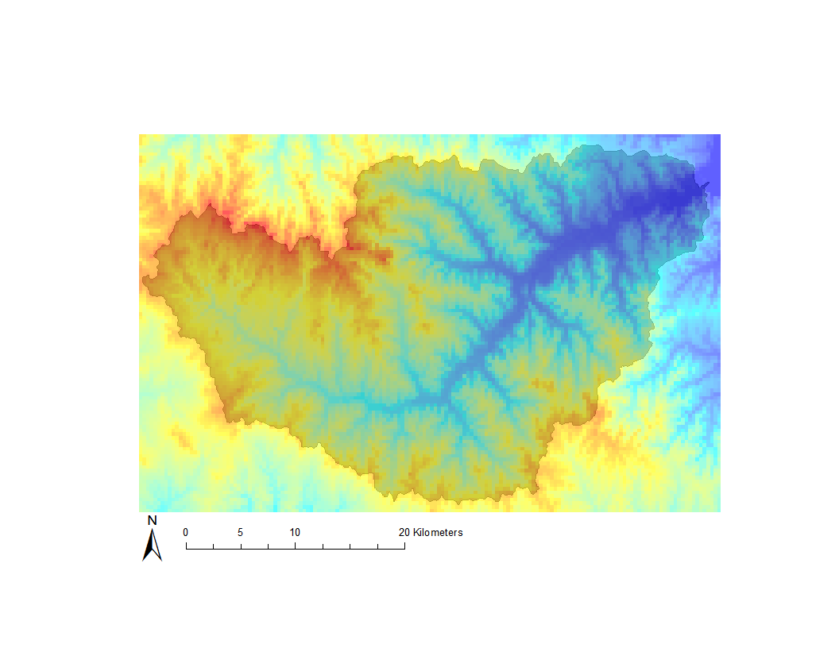
Testing and Validation
NWM CONUS
x = 4608 km
y = 3840 km
~ 30 Gb
Little Washita
x = 160 km
y = 104 km
~ 70 Mb
Notes:
10 day cold-start NWM CONUS simulation on Cheyenne
Omitting nudging, lakes, and restart
Compared against subset simulation
Produced exact same streamflow results
Further testing and validation is ongoing

Slide 7
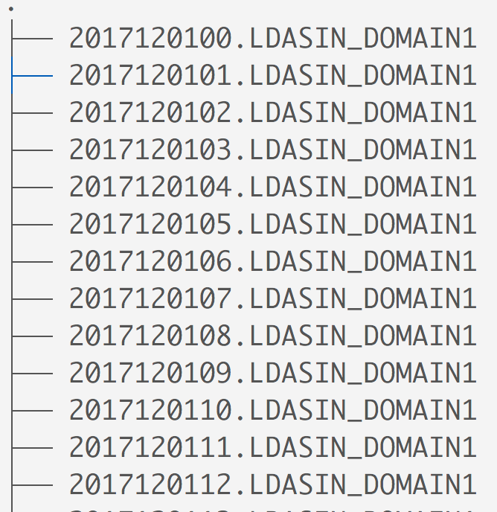

Real-world Use Case - Zhiyu “Drew” Li (BYU)
Is it possible to reproduce operational analysis results?
Subsetting DOMAIN and archived FORCING
Implemented in the HydroShare NWM Viewer
RUN DIR
DOMAIN
FORCING
https://hub.docker.com/r/wrfhydro/dev/
https://github.com/NCAR/wrf_hydro_nwm_public
Notes:
Operational model will have differences so we’re really just trying to see if we can get reasonable accuracy.

Slide 8
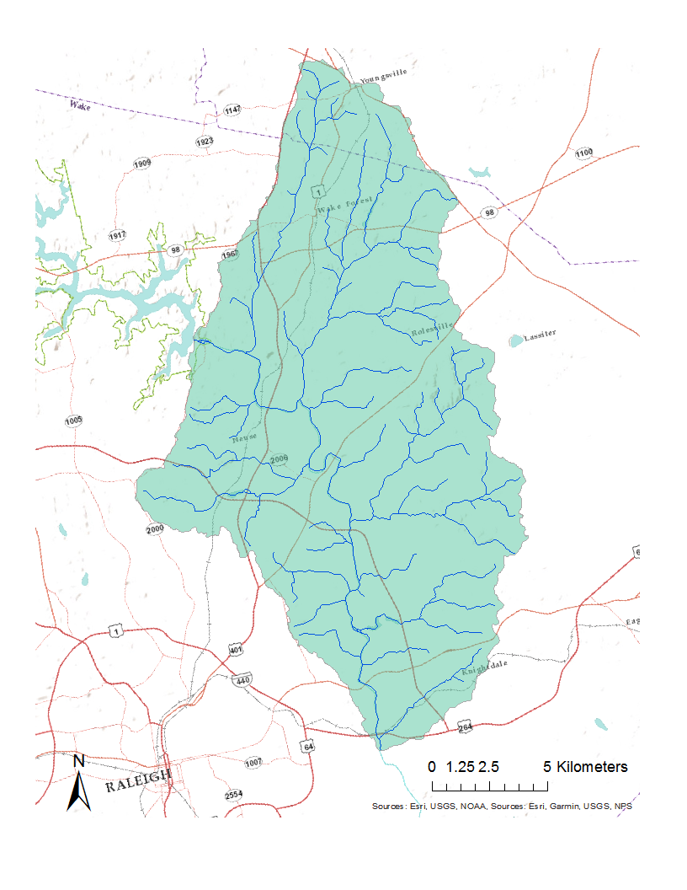
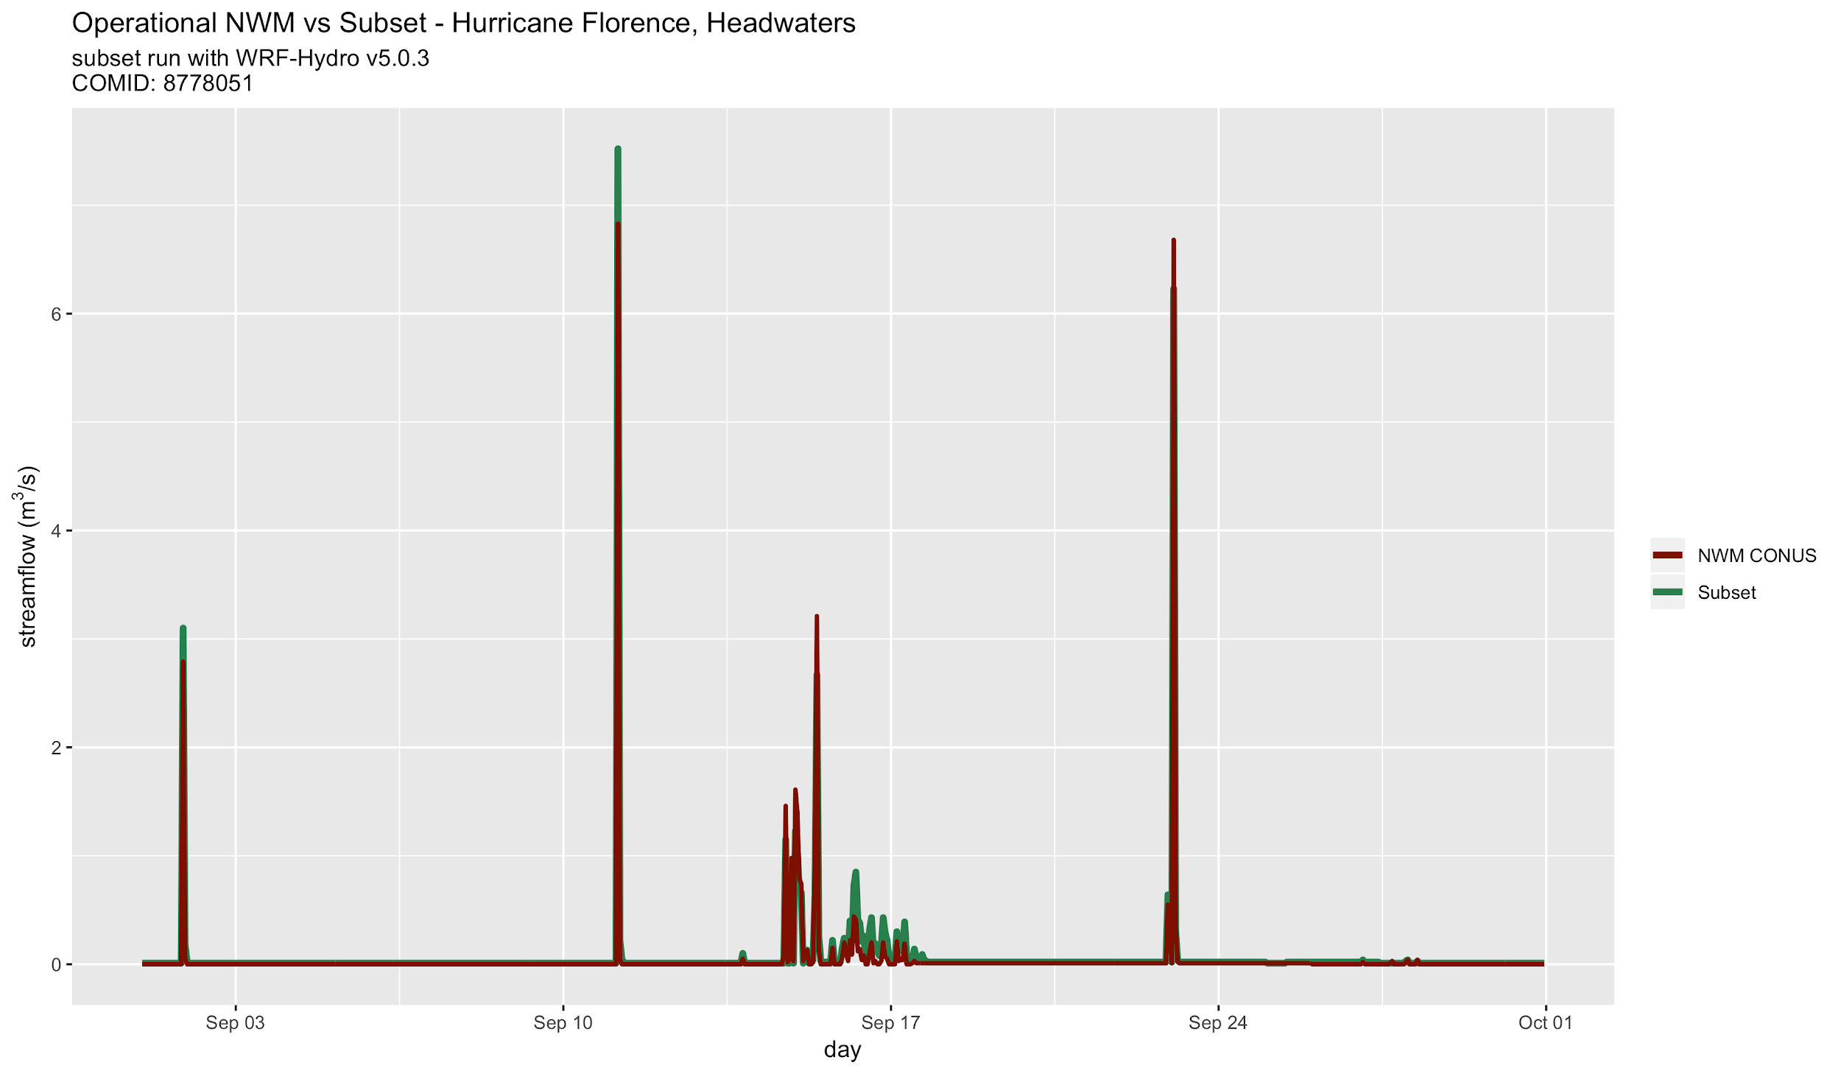
Milburnie, NC - Headwater

Slide 9
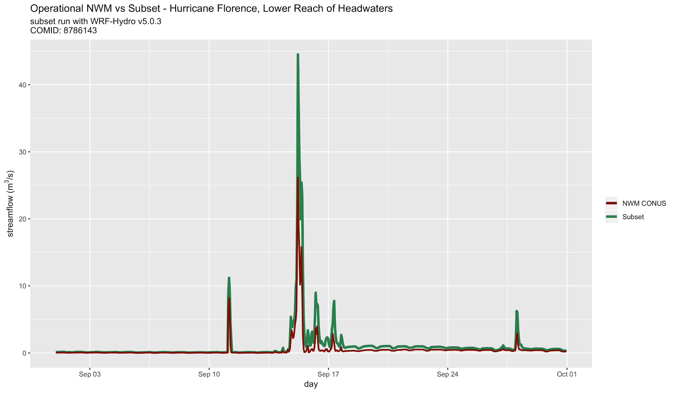
Milburnie, NC – Lower Catchment

Slide 10
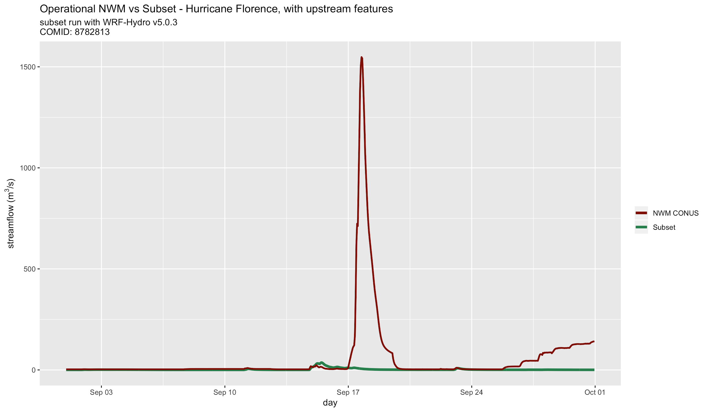
Milburnie, NC - Upstream

Slide 11
Conclusions
Publicly available service to make CONUS domains more accessible
Designed to use pre-existing subsetting scripts
Currently being integrated into other web applications, e.g. HydroShare NWM viewer
Undergoing benchmarking and validation testing
Extendable to other CONUS models
http://subset.cuahsi.org:8080

Slide 12
Thank You
Anthony M. Castronova, acastronova@cuahsi.org
Danielle Tijerina, dtijerina@cuahsi.org
Aubrey L Dugger
Arezoo Rafieeinasab
Joe Mills
David Gochis
Zhiyu Li, IN41D-0865: Building Web Applications to Support the Execution of NWM at Watershed Scales (Thursday 8:00am-12:20am)
http://subset.cuahsi.org:8080

